Slide 1
Detecting Face Mask using AI, ML and DL for COVID-19 Prevention
Submitted in the partial fulfillment for the award of the degree of
BACHELOR OF ENGINEERING
IN
AIML
Submitted by:
Toshiba Ansari (20BCS6671)
Abhishek Singh (20BCS6673)
Pushp Jain (20BCS6706)
Rahul Goyal (20BCS6713)
Under the Supervision of:
Ms Leeza Sharma
Assistant Professor
Dept. AIT-CSE
Department of AIT-CSE
DISCOVER . LEARN . EMPOWER

Slide 2
Outline
Problem Formulation
Introduction to Project
Hardware and Software Requirement
Objectives
Methodology used
Outputs
Conclusion
Future Scope
References

Slide 3
Problem Formulation
In the post pandemic era, people are not following Covid-19 guidelines and have become careless about their face masks.
In public places, face masks needs to be checked for every person.
It will be very difficult if we deploy a single person to check for these masks.
So we have made this task easy through our project.

Slide 4
Introduction to Project
In this project, we are introducing the concept of detecting the face mask of a person.
We have used the concept of AI, ML and Deep Learning.
MobileNetV2 is the main model of our project.
We made a real time video surveillance for the deployment in the real world.
The dataset has been collected from arXiv.org.
We have managed to surpass the accuracy level of other existing models.
An alert message will be generated if the person is without mask for the time period of 2 min.

Slide 5
Hardware and Software Requirement
Laptop with 4 GB RAM
Internet connectivity with 2MBPS speed
Python Language and Jupyter Notebook
OpenCV
TensorFlow and Keras
Imutils
Harcasscade classifier
Sklearn etc.

Slide 6
MobileNetV2
MobileNetV2 is a very effective feature extractor for object detection and segmentation which uses depth wise separable convolution as its basic unit.
Its depth wise separable convolution has two layers: depth wise convolution and point convolution.
It is based on an inverted residual structure where the residual connections are between the bottleneck layers. The intermediate expansion layer uses light-weight depth wise convolutions to filter features as a source of non-linearity.
As a whole, the architecture of MobileNetV2 contains the initial fully convolution layer with 32 filters, followed by 19 residual bottleneck layers. It has 53 deep layers.

Slide 7
Objectives
To load dataset and train facemask classifier with TensorFlow then serializing it to disk followed by loading it up from disk to detect face in image.
Extracting each face ROI to determine “Mask” or “No Mask”.
To learn various machine learning, deep learning techniques. And to enhance our knowledge in this aspect.
To use clean data for more accurate results.
To analyze our data without any bias.

Slide 8
Methodology used
The following methodology will be followed to achieve the objectives defined for proposed work:
Training- We load our face mask detection dataset from disk, train a model by using Keras/TensorFlow on this dataset, and then serializing the face mask detector to disk.
Deployment- Once the face mask detector is trained, we can then move on to loading the mask detector, performing face detection, and then classifying each face as with mask or without mask.

Slide 9
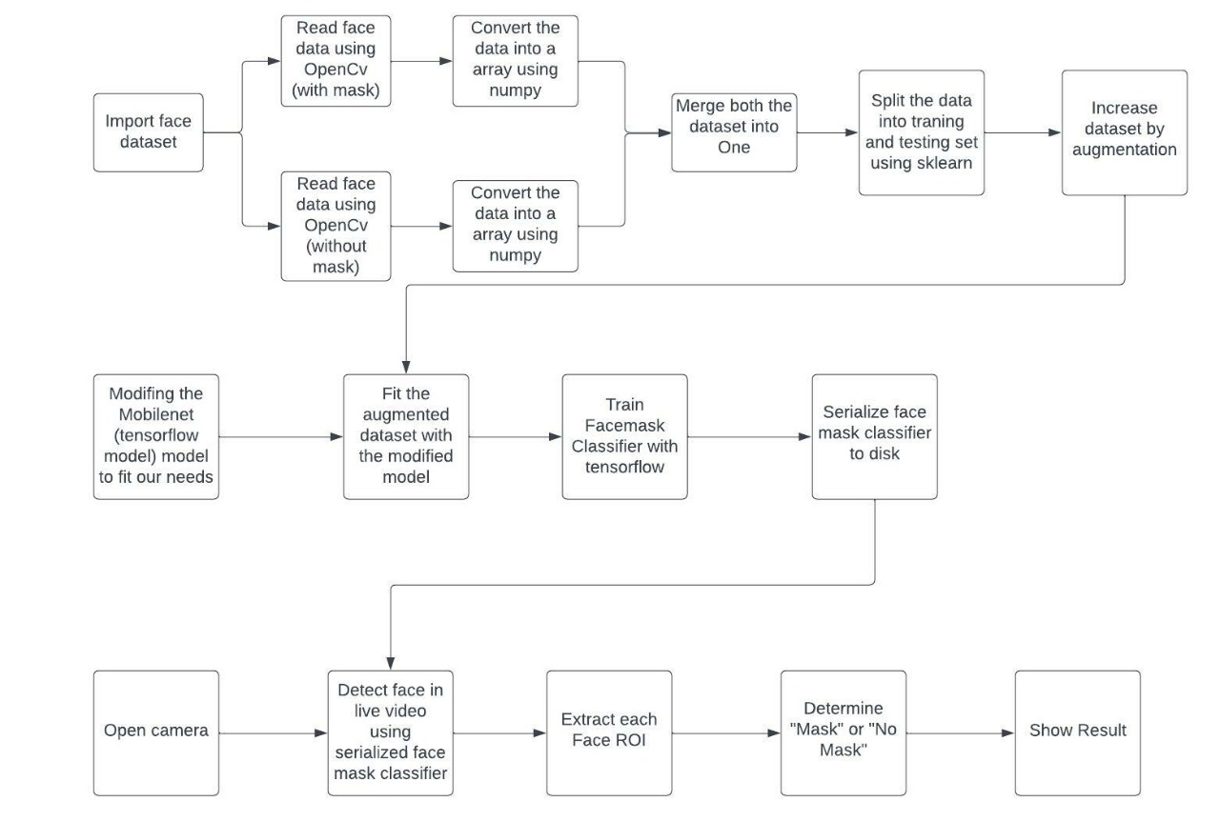
Flow Chart

Slide 10


Outputs

Slide 11
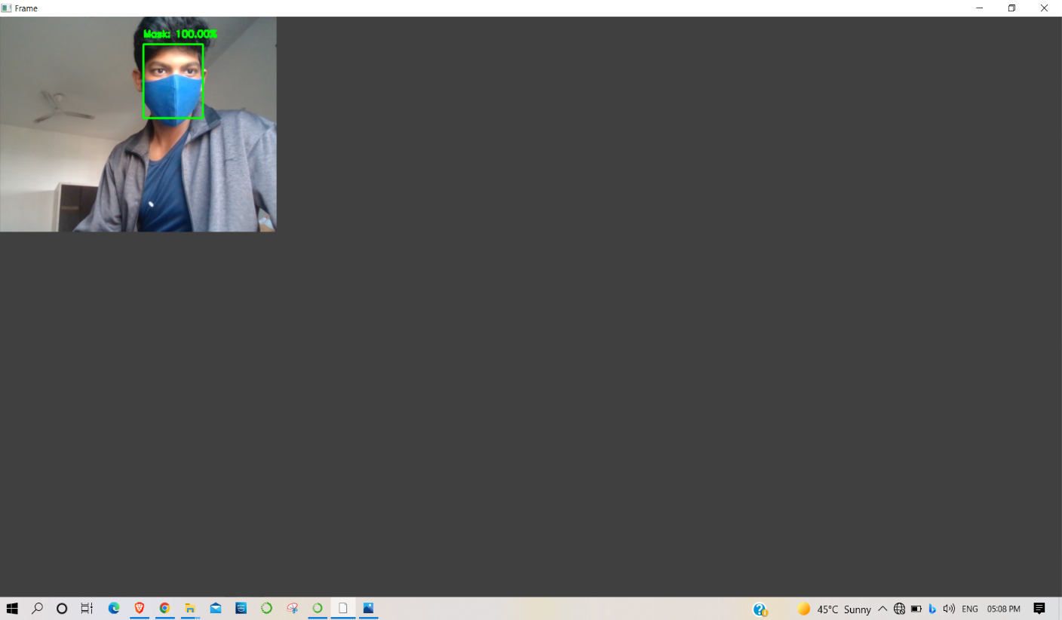
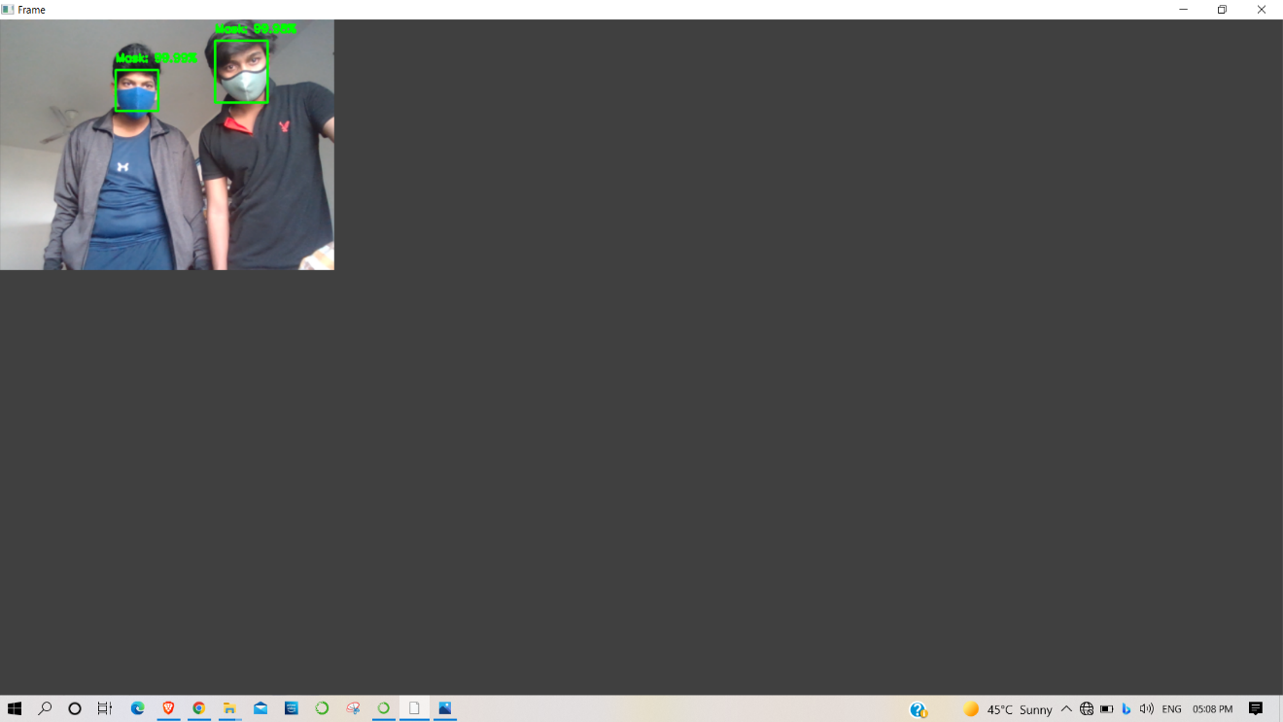
Outputs

Slide 12
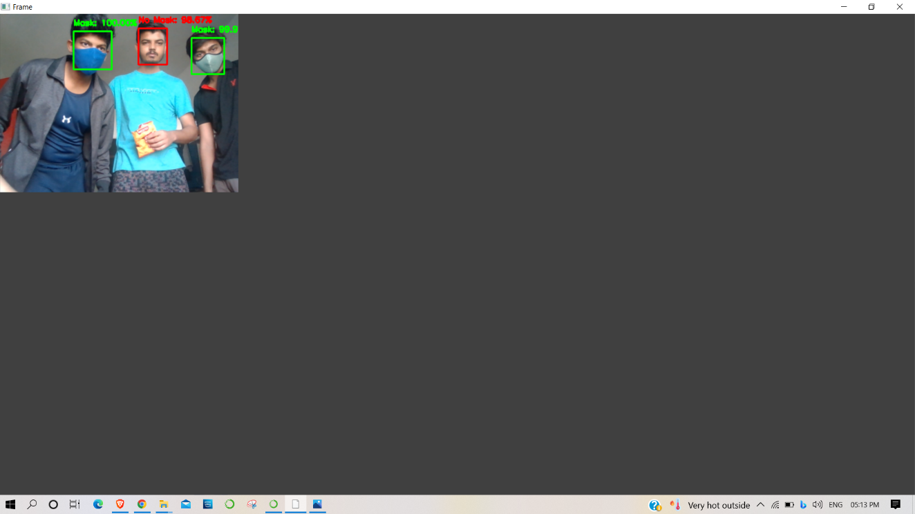

Outputs

Slide 13
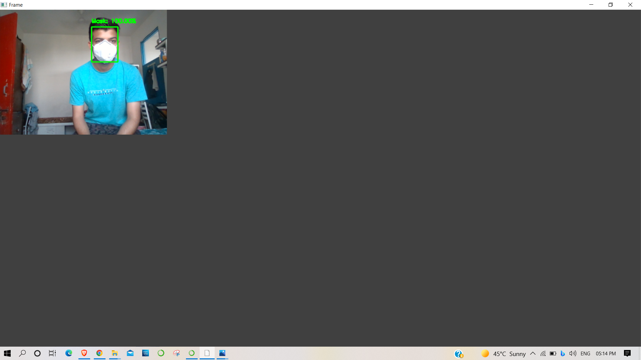
Outputs

Slide 14
Conclusion
To moderate the spread of the COVID-19 pandemic, measures should be taken. We have demonstrated a face mask detector using CNN and MobileNetV2.
To train, validate and test the model, we utilized the dataset that consisted of 1125 masked faces pictures and 1184 exposed faces pictures. These pictures were taken from arxiv.org. The model was induced live video transfers.
To choose a base model, we assessed the measurement like accuracy and we got 98% accuracy.
This face mask detector can be sent in numerous regions like shopping centers, air terminals, substantial traffic places and ,mainly in primary schools to screen children and people in general and to dodge the spread of the infection by checking who is following essential rules and who isn’t.

Slide 15
Future Scope
The present model proposed gives great accuracy for single face with and without mask. For multiple faces also it gives quite good accuracy.
It works easily on any mobile device just by switching on the video stream, with no external hardware requirement.
Further we will work to classify the faces into three categories that is, With mask, without mask, Improper mask instead of just the two with and without mask class by adding datasets with images of people wearing masks not covering their noses properly and also to detect the masked face using the Face-Net model of Convolutional Neural Network.
So as to further improve our model and add marking attendance feature in it by detecting the face even when the mask is on.

Slide 16
References
[1] M.Loey, G.Manogaran, M.H.N.Taha, and N.E.M.Khalifa, “A hybrid deep transfer learning model with machine learning methods for face mask detection in the era of theCOVID-19 pandemic,” Measurement, vol.167,ArticleID108288,2021.
[2] Z. Wang, P. Wang, P. C. Louis, L. E. Wheless, and Y. Huo, “Wearmask: fast In-browser face mask detection with serv- erless edge computing for COVID-19,” 2021, https://arxiv. org/abs/2101.00784.
[3] S.K.Dey, A.Howlader, and C.Deb, “Mobile Net mask: a multi-phase face mask detection model to prevent person-to- person transmission of SARS-CoV-2,” in Proceedings of International Conference on Trends in Computational and Cognitive Engineering, pp.603–613,Springer,Dhaka,Bangladesh, December2021.
[4] “Coronavirus Disease 2019 (COVID-19) – Symptoms”, Centers for Disease Control and Prevention, 2020. [Online]. Available: https://www.cdc.gov/coronavirus/2019-ncov/symptomstesting/symptoms.html.2020
[5] M. Jiang, X. Fan and H. Yan, “Retina Mask: A Face Mask detector”, arXiv.org, 2020. [Online]. Available: https://arxiv.org/abs/2005.03950.2020
[6] M.Perc, M.Ozer, and J.Hojnik, “Social and juristic challenges of artificial intelligence,” Palgrave Communications, vol.5, no. 1,pp.1–7,2019.

Slide 17
References (Cont.)
[7] Gagandeep Kaur ∗, Ritesh Sinha, Puneet Kumar Tiwari, Srijan Kumar Yadav, Prabhash Pandey, Rohit Raj, Anshu Vashisth, Manik Rakhra “Face mask recognition system using CNN model”, 2021.
[8] A. A. Abd El-Aziz††, Nesrine A. Azim††, Mahmood A. Mahmood†, ††, and Hamoud Alshammari† “A Deep Learning Model for Face Mask Detection”, 2021.
[9] Safa Teboulbi, Seifeddine Messaoud, Mohamed Ali Hajjaji and Abdellatif Mtibaa “Real-Time Implementation of AI-Based Face Mask Detection and Social Distancing Measuring System for COVID-19 Prevention” Article id- Volume 2021, Article ID 8340779, 21 pages, 2021.
[10] Eashan Adhikarla Brian D. Davison “Face Mask Detection on Real-World Webcam Images”, 2021.
[11] Mr.Kalla.Kiran , Bokka Vamsi Kiran, Devarapalli Cheswanth Sai , Gaggala Vijay Vamsi Pitta Rani Salomi “FACE MASK DETECTION USING MACHINE LEARNING” , 2021.

Slide 18
THANK YOU!

